Slide 1
Hacker Techniques, Tools, and Incident Handling
Chapter 6
Port Scanning

Slide 2
Learning Objective
Identify common information-gathering tools and techniques.

Slide 3
Key Concepts
Determining the network range
Identifying active machines
Mapping open ports
Operating system (OS) fingerprinting
Network mapping

Slide 4
Determining the Network Range
Gather information about the range of the Internet Protocol (IP) addresses used by the target
Enables port scanning to be more accurate and effective as only the IP addresses of the intended victim are scanned
Lack of network range information results in inaccurate and ineffective scans and may set off detection measures

Slide 5
Identifying Active Machines
Wardialing
Wardriving and related activities
Pinging
Port scanning

Slide 6
Wardialing
Legacy technique popular in the 1980s and 1990s when it was used as a footprinting tool
An attacker would pick a town at random and dial a range of phone numbers in that town to turn up several computers with modems attached

Slide 7
Wardriving and Related Activities
Wardriving
The process of locating wireless access points and gaining information about the configuration of each
Enables an attacker to gain quick and easy access to the internal network of a company
Ease of carrying a small device with a wireless adapter, GPS receiver, and software to collect information gave rise to warwalking, warjogging, warbiking, and warflying
Notes:
Wardriving is successful because personnel sometimes install their own access points on the company network without company permission (known as a rogue access point).
An individual who installs an access point in such a way will more than likely have no knowledge of, or possibly not care about, good security practices and may well leave the access point completely unsecured.

Slide 8
Wardriving and Related Activities (Cont.)
Tools for defending against wardriving:
AirSnort—Wireless cracking tool
AirSnare—An intrusion detection system that notifies you when an unapproved machine connects to your wireless network
Kismet—Wireless network detector, sniffer, and intrusion detection system commonly found on Linux
NetStumbler—Wireless network detector; also available for Mac and handheld devices

Slide 9
Pinging
A technique used to determine if a system is active
Pings:
Send an Internet Control Message Protocol (ICMP) message
Can be used to identify active machines, measure speed at which packets are moved from one host to another, and obtain details such as the time to live (TTL)

Slide 10
Port Scanning
A technique used to discover what services are active on a system
Designed to probe each port on a system in an effort to determine which ports are open
Very effective method for gaining host information

Slide 11
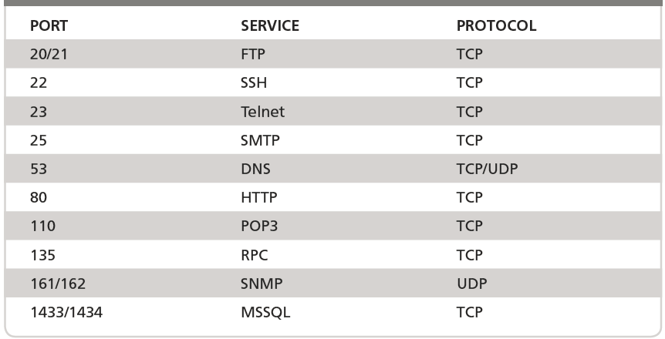
Port Scanning: Common Port Numbers

Slide 12
TCP Port Scanning Techniques
Flags are used in TCP protocol to describe status of a packet and the communication that goes with it
Flags are bits set in packet header, describe a specific behavior
TCP features enable penetration testers or attackers to craft TCP packets designed to gain information about running applications or services

Slide 13
TCP Port Scanning Techniques (Cont.)
TCP connect scan
TCP SYN scan
TCP FIN scan
TCP NULL scan
TCP ACK scan
TCP ACK scan
Notes:
Some popular scans designed for TCP port scanning:
TCP connect scan — Most reliable scan but easiest to detect. Can be easily logged and detected because a full connection is established. Open ports reply with a SYN/ACK, whereas closed ports respond with an RST/ACK.
TCP SYN scan — Commonly referred to as “half open” because a full TCP connection is not established. This type of scan was originally developed to be stealthy and evade IDS systems, although most modern systems have adapted to detect it. Open ports reply with a SYN/ACK, whereas closed ports respond with an RST/ACK.
TCP FIN scan — attempts to detect a port by sending a request to close a nonexistent connection. This type of attack is enacted by sending a FIN packet to a target port; if TCP NULL scan—This attack is designed to send packets with no flags set. The goal is to elicit a response from a system to see how it responds and then use the results to determine the ports that are open and closed.
TCP ACK scan — Attempts to determine access control list (ACL) rule sets or identify whether stateless inspection is being used. If an ICMP destination is unreachable, the port is considered to be filtered.
TCP ACK scan — Functions by sending packets to a target port with flags set in combinations that are illegal or illogical (e.g., FIN, PSH, and URG). The
results are then monitored to see how a system responds. Closed ports should return an RST.

Slide 14
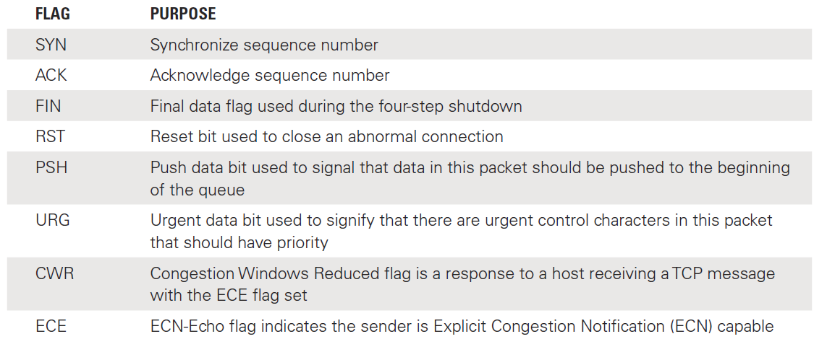
TCP Port Scanning Techniques: TCP Flag Types

Slide 15
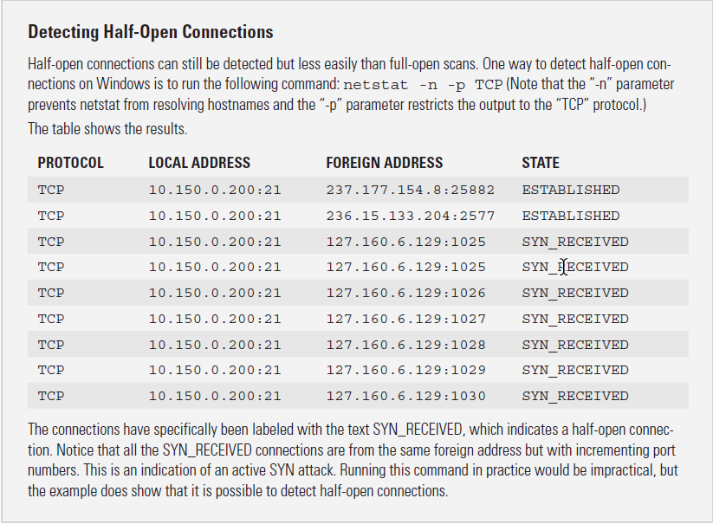
Detecting Half-Open Connections

Slide 16
Port Scanning Countermeasures
Deny all
Proper design
Firewall testing
Port scanning
Security awareness training
Notes:
Deny all — An approach that blocks traffic to all ports unless the traffic has been approved
Proper design — An aspect of a carefully planned attack
Firewall testing — A way to verify a firewall’s capability to detect and black undesirable traffic
Port scanning — A technique that uses the same tools that an attacker will use to attack a system
Security awareness training — Teaches employees how to look for behaviors and maintain security and encourage security policies and practices are followed

Slide 17
Mapping Open Ports
Nmap
SuperScan
Scanrand
THC-Amap

Slide 18
Nmap
Nmap (Network Mapper)
One of the most widely used security tools
Is a port scanner with capability to perform a number of different scan types
Available in Windows, Linux, MacOS, and others
Command-line application and graphical user interface (GUI) version (Zenmap)
To perform an Nmap scan at Windows command prompt:
nmap <IP address> <options>

Slide 19
Nmap (Cont.)
Example: nmap –sT 192.168.123.254
Response:
Starting Nmap 7.60 (http://nmap.org) at 2017-10-17 10:37
Central Daylight Time
Interesting ports on 192.168.123.254:
Not shown: 1711 filtered ports
PORT STATE SERVICE
21/tcp open ftp
80/tcp open http
2601/tcp open zebra
2602/tcp open ripd
MAC Address: 00:16:01:D1:3D:5C (Linksys)
Nmap done: 1 IP address (1 host up) scanned in 113.750 seconds

Slide 20
Using Nmap
Results display status of port in one of three states:
Open: Target device is accepting connections on the port
Closed: Port is not listening or accepting connections
Filtered: Firewall, filter, or other network device is monitoring the port and preventing full probing to determining its status

Slide 21
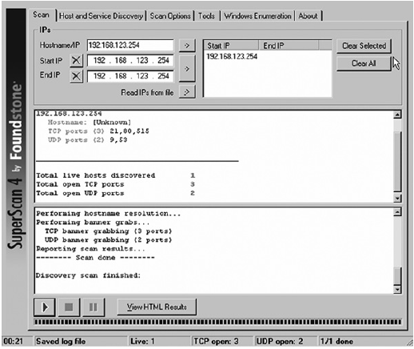
SuperScan
Notes:
SuperScan is a Windows-based port scanner designed to scan TCP and UDP ports, perform ping scans, run Whois queries, and use Traceroute.

Slide 22
Scanrand
Scanning tool
Scans ports in parallel using technique known as stateless scanning
Used when large numbers of IP addresses need to be scanned quickly
Can scan a single host or large-scan networks

Slide 23
THC-Amap
THC-Amap (The Hacker’s Choice – Another Mapper)
Stores a collection of normal responses that can be provided to ports to elicit a response when scanning services that use encryption
Allows security professionals the ability to find services that have been redirected from standard ports

Slide 24
OS Fingerprinting
Open ports that are discovered provide clues to what operating system (OS) a target is running
Determining the OS that is running on a specific target is the purpose of OS fingerprinting
Once an OS is identified, it is possible to better focus attacks
Active fingerprinting
Passive fingerprinting
Notes:
OS fingerprinting relies on the unique characteristics that each OS exhibits during normal operation.
Each OS responds to communication attempts in different ways that can provide clues for a well-educated guess to be made about the system in place.
To determine these unique characteristics, active and passive fingerprinting can probe a system to generate a response or listen to a system’s communications for details about the OS.

Slide 25
OS Fingerprinting (Cont.)
Passive OS fingerprinting
Generally does not yield results as quickly as active OS fingerprinting
Allows an attacker to obtain information about a target without triggering network defensive measures
Victim has less chance of detecting and reacting to the impending attack
Active OS fingerprinting
Contacts host; passive fingerprinting does not

Slide 26
Active OS Fingerprinting
Send specially crafted packets to target system
When responses are received from target system, make educated guess as to the operating system that is present
Examples of tools:
Xprobe2
Nmap

Slide 27
Passive OS Fingerprinting
Does not interact with the target system
Monitors or captures network traffic
Traffic is analyzed for patterns that suggest which operating systems are in use
Offers a level of stealth; harder to detect these tools
Example of passive OS fingerprinting tool
p0f Tool

Slide 28
Mapping the Network
Create a network diagram to show vulnerable or potentially vulnerable devices on target network
Tools
SolarWinds, Auvik, Open-AudIT, The Dude, Angry IP Scanner, Spiceworks Map IT, and Network Notepad
Manual maps
Record info in notebook or spreadsheet

Slide 29
Analyzing the Results
Analyze the services that have been revealed.
Explore vulnerabilities for each service or system.
Research and locate any potential exploits that can be used to attack the system.
The attacker can use a search engine to gather information about potential attacks by searching the OS and exploits.

Slide 30
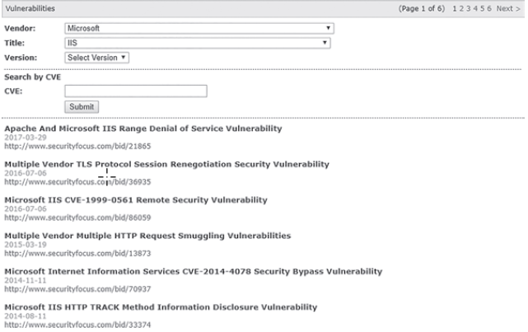
Microsoft IIS Vulnerabilities

Slide 31
Summary
Identification of target systems
Port and vulnerability scanning techniques
Network mapping tools

